Slide 1

CSC 1004: Tutorial 8
Introduction of Snake Game and
Python Tkinter
Bo Yue
SDS, CUHK-SZ

Slide 2
Basic Function
The player's goal is to control a snake to eat as much food as possible, causing the snake to grow longer and learning a higher score.
The snake continuously moves forward, and the player can control its direction to find food at a fixed speed.
Food items randomly appear on the game board, typically represented as small dots or icons. The snake must consume these food items to increase its length and score. Once the snake eats the food, new food appears at another location on the map.
There should be two types of foods. Each food corresponds to a different increasing of the snake's length. Every time the snake consumes food, its length increases either one or two units.
The game ends under the following conditions: 1) The snake collides with the boundaries of the game area. 2) The snake collides with its own body, essentially running into itself. 3) The snake reaches its maximum length (8 units).

Slide 3
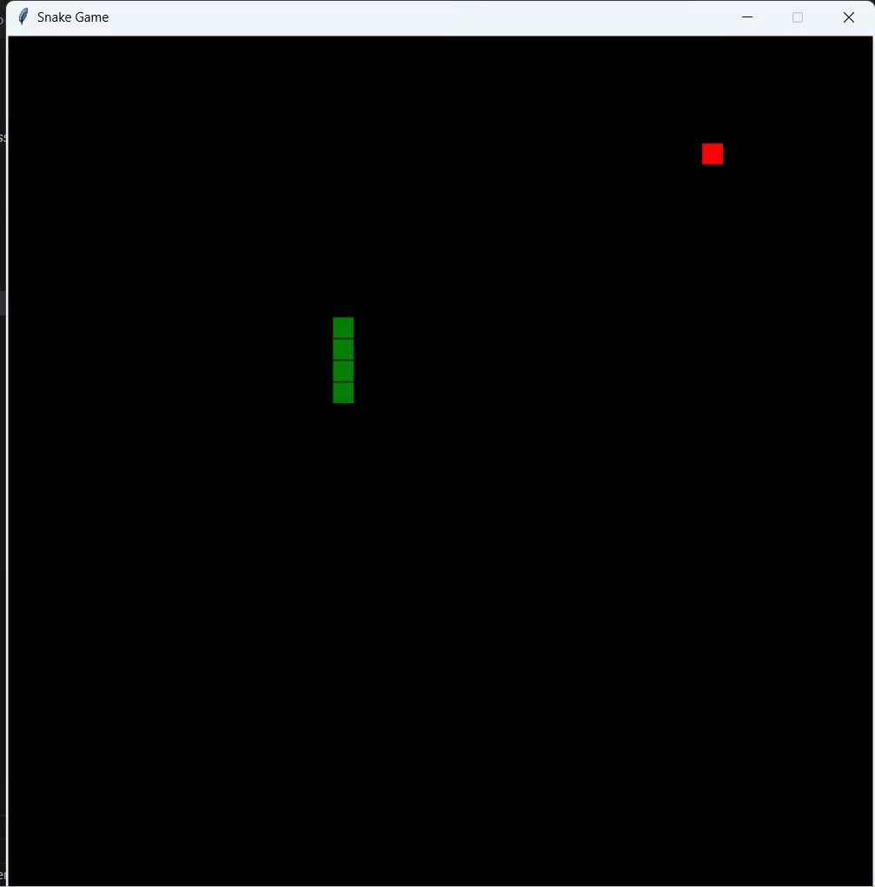
Advanced Function
Different Effects of Food
Adding Obstacles
Adding score function
Multi-Level Challenges
Dynamic velocity
Adding start menu
More exploration ...

Slide 4
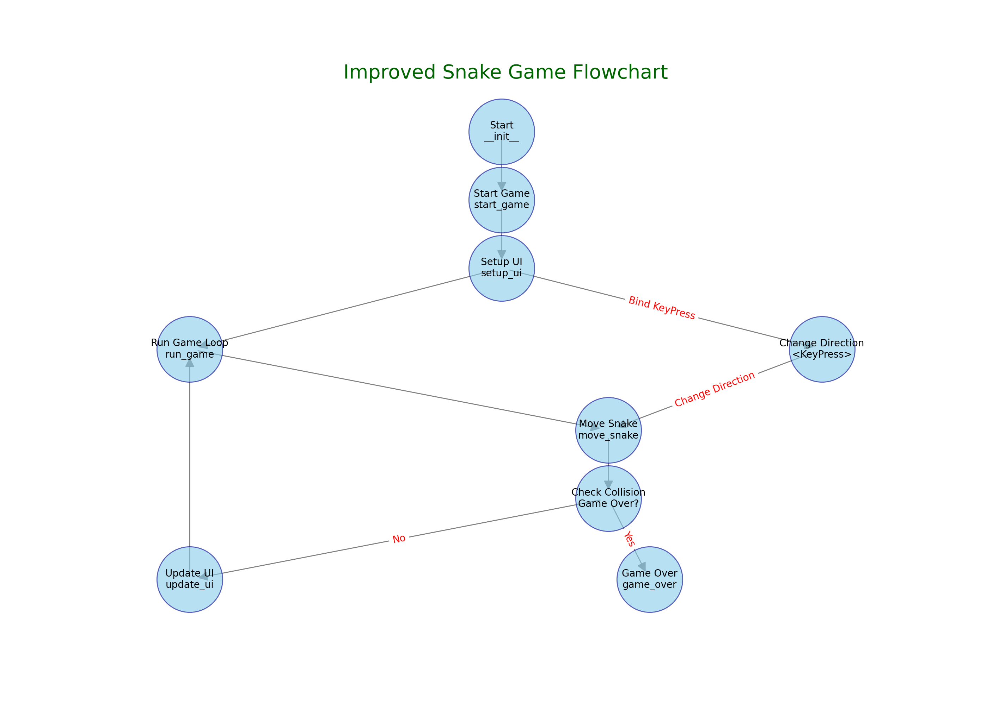
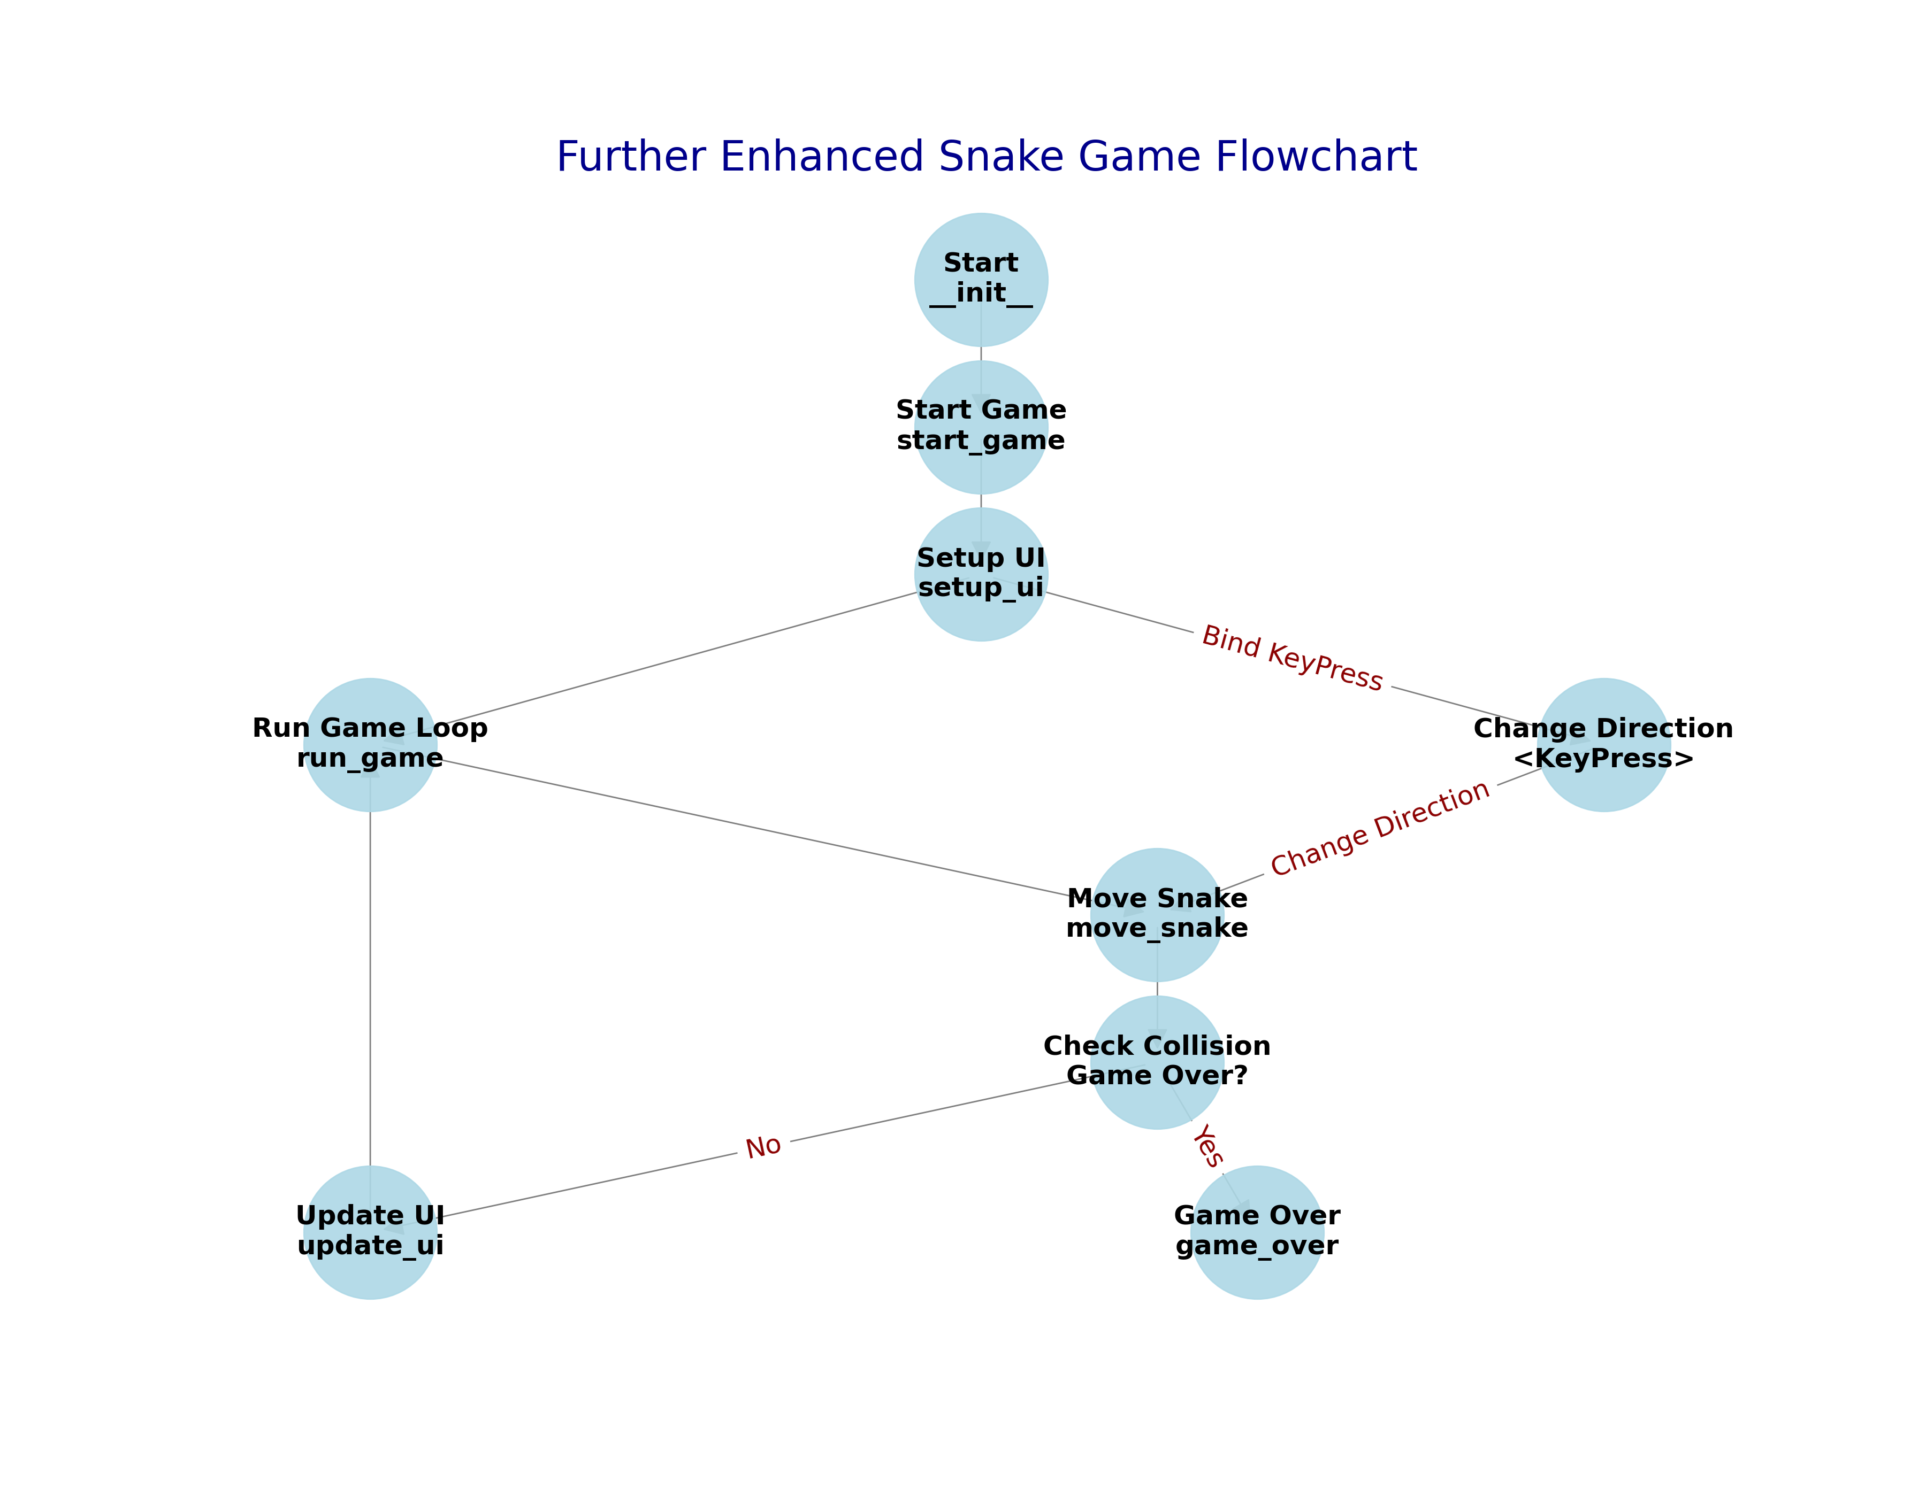
Project Logic Chain

Slide 5
def create_food(self):
while True:
x = random.randint(0, (self.width//self.cell_size)-1) * self.cell_size
y = random.randint(0, (self.height//self.cell_size)-1) * self.cell_size
food = (x, y)
if food not in self.snake:
return food
project code framework
def move_snake(self):
if self.snake_direction == 'Left':
...
if new_head == self.food:
...
self.food = self.create_food()
if (new_head[0] < 0 or new_head[0] >= self.width or
new_head[1] < 0 or new_head[1] >= self.height or
new_head in self.snake[1:]):
self.game_over()
...
self.update_ui()
if __name__ == "__main__":
game = SnakeGame()
game.mainloop()
def game_over(self):
self.canvas.create_text(self.width//2, self.height//2, text="Game Over", fill="white", font=('TkDefaultFont', 24))
self.unbind("<KeyPress>")
def update_ui(self):
self.canvas.delete('all')
...
self.canvas.create_rectangle()
class SnakeGame(tk.Tk):
def __init__(self):
super().__init__()
self.title("Snake Game")
self.geometry("800x800")
self.resizable(False, False)
...
self.start_game()
def run_game(self):
self.move_snake()
self.after(100, self.run_game)
def change_direction(self, event):
...
self.snake_direction = event.keysym
def start_game(self):
...
self.setup_ui()
self.run_game()
def setup_ui(self):
self.update_ui()
self.bind("<KeyPress>", self.change_direction)

Slide 6
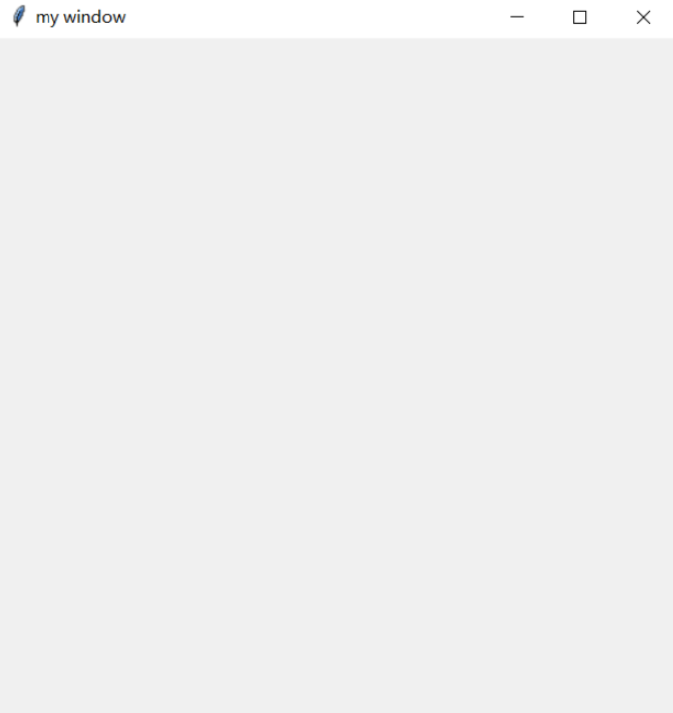
Tkinter mainloop
if you want to create a Tkinter GUI
import tkinter
window = tkinter.Tk()
window.title('my window')
window.geometry('500x500')
window.mainloop()

Slide 7
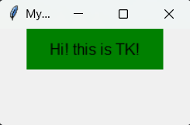
Tkinter Label (1)
import tkinter as tk
window=tk.Tk()
window.title('Mywindow')
window.geometry('200x100')
l = tk.Label(window,
text='Hi! this is TK!',
bg='green',
font=('Arial', 12),
width=15,
height=2
)
l.pack()
window.mainloop()

Slide 8
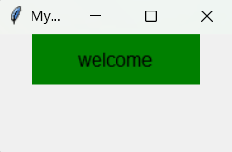
Tkinter Label (2)
import tkinter as tk
window=tk.Tk()
window.title('Mywindow')
window.geometry('200x100')
var=tk.StringVar()
var.set(‘welcome’)
l = tk.Label(window,
textvariable=var,
bg='green',
font=('Arial', 12),
width=15, height=2)
l.pack()
window.mainloop()

Slide 9
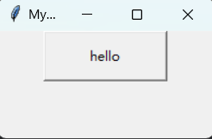
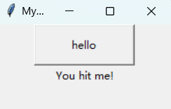
Tkinter Button
import tkinter as tk
window=tk.Tk()
window.title('Mywindow')
window.geometry('200x100')
on_hit=False
var = tk.StringVar()
def hit_me():
global on_hit
if on_hit==False:
on_hit=True
var.set('You hit me!')
else:
on_hit=False
var.set('')
b=tk.Button(window,text='hello',width=15,height=2,command=hit_me)
b.pack()
label = tk.Label(window, textvariable=var)
label.pack()
window.mainloop()

Slide 10
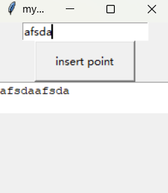
Tkinter Entry & Text
import tkinter as tk
window = tk.Tk()
window.title('my window')
window.geometry('200x200')
e=tk.Entry(window,show=None)
e.pack()
def insert_point():
var=e.get()
t.insert('insert',var)
b = tk.Button(window,text="insert point",width=15,
height=2,command=insert_point)
b.pack()
t=tk.Text(window,height=2)
t.pack()
window.mainloop()

Slide 11
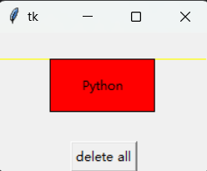
Tkinter Canvas
import tkinter as tk
root = tk.Tk()
w = tk.Canvas(root, width =200, height = 100)
w.pack()
line1 = w.create_line(0, 50, 200, 50, fill = "yellow")
line2 = w.create_line(100, 0, 100, 100, fill = "red", dash = (4, 4))
rect1 = w.create_rectangle(50, 25, 150, 75, fill = "blue")
w.coords(line1, 0, 25, 200, 25)
w.itemconfig(rect1, fill = "red")
w.delete(line2)
w.create_text(100, 50, text = "Python")
tk.Button(root, text = "delete all", command = (lambda x = "all" : w.delete(x))).pack()
root.mainloop()

Slide 12
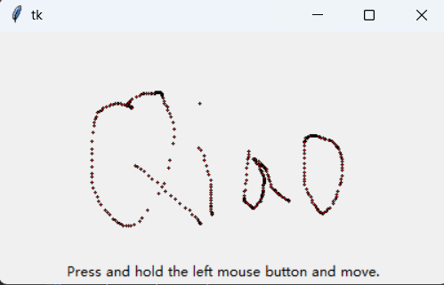
Tkinter Canvas
import tkinter as tk
root = tk.Tk()
w = tk.Canvas(root, width = 400, height = 200)
w.pack()
def paint(event):
x1, y1 = (event.x - 1), (event.y - 1)
x2, y2 = (event.x + 1), (event.y + 1)
w.create_oval(x1, y1, x2, y2, fill = "red")
w.bind("<B1-Motion>", paint)
tk.Label(root, text = "Press and hold the left mouse button and move.").pack(side = "bottom")
root.mainloop()

Slide 13
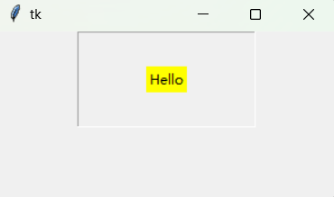
Tkinter Frame
from tkinter import *
root=Tk()
root.geometry('300x150+888+444')
fr1=Frame(root,relief='groove',bd=1,padx=60,pady=30)
fr1.pack()
la1=Label(fr1,text='Hello',bg='yellow')
la1.pack()
root.mainloop()

Slide 14
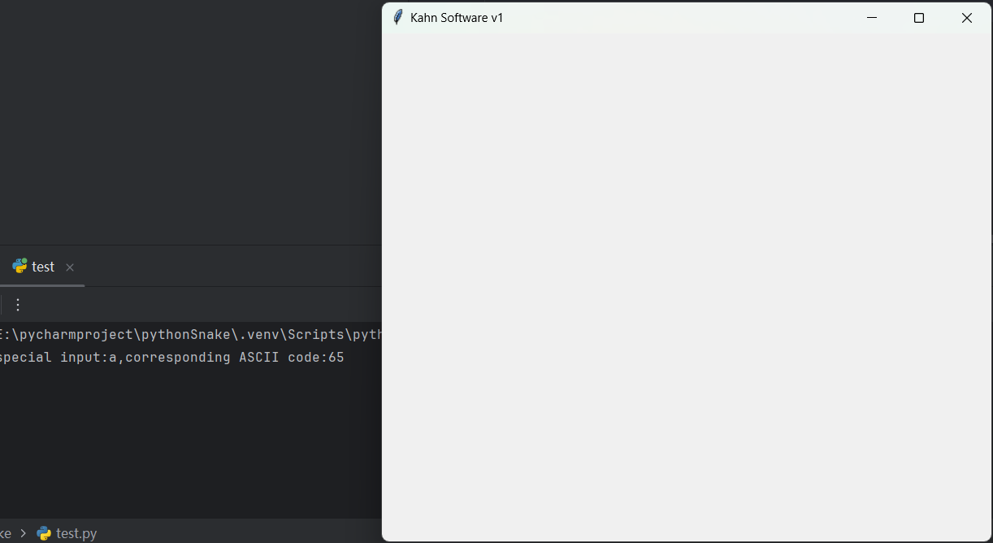
Tkinter key_event
import tkinter
def xFunc1(event):
print(f"special input:{event.char},corresponding ASCII code:{event.keycode}")
win = tkinter.Tk()
win.title("Kahn Software v1")
win.geometry("600x500+200+20")
win.bind("a", xFunc1)
win.mainloop()

Slide 15
Python Class (1)
class people:
#define basic(public) attribute
name = ''
age = 0
#define private attribute
__weight = 0
#initialization
def __init__(self,n,a,w):
self.name = n
self.age = a
self.__weight = w
def speak(self):
print("%s say: I %d years old。" %(self.name,self.age))
# Instantiate a class
p = people('runoob',10,30)
p.speak()

Slide 16
Python Class (2) Inheritance
class people:
name = ''
age = 0
__weight = 0
def __init__(self,n,a,w):
self.name = n
self.age = a
self.__weight = w
def speak(self):
print("%s 说: 我 %d 岁。" %(self.name,self.age))
class student(people):
grade = ''
def __init__(self,n,a,w,g):
people.__init__(self,n,a,w)
self.grade = g
def speak(self):
print("%s say: I’m %d years old，and my grade is %d"%(self.name,self.age,self.grade))
s = student('ken',10,60,3)
s.speak()

Slide 17
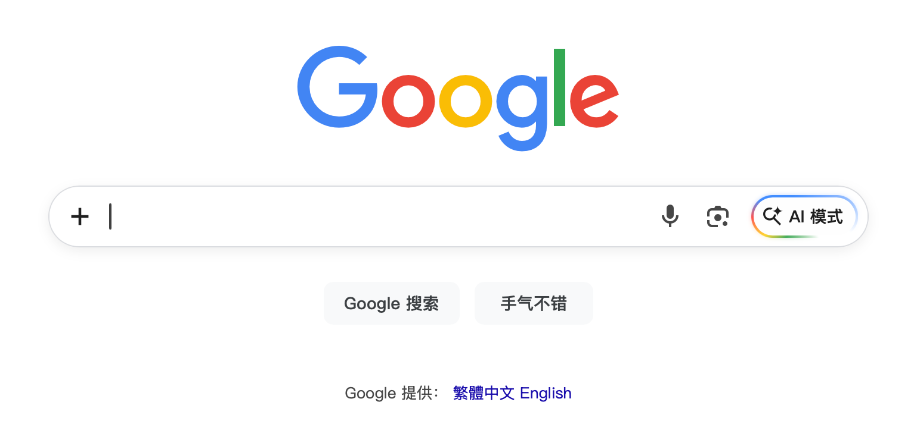
Search the web to learn
Use a browser to search your questions on Internet
Browser: Chrome/Edge/Safari/Firefox
Website: bing.com/google.com

Slide 18
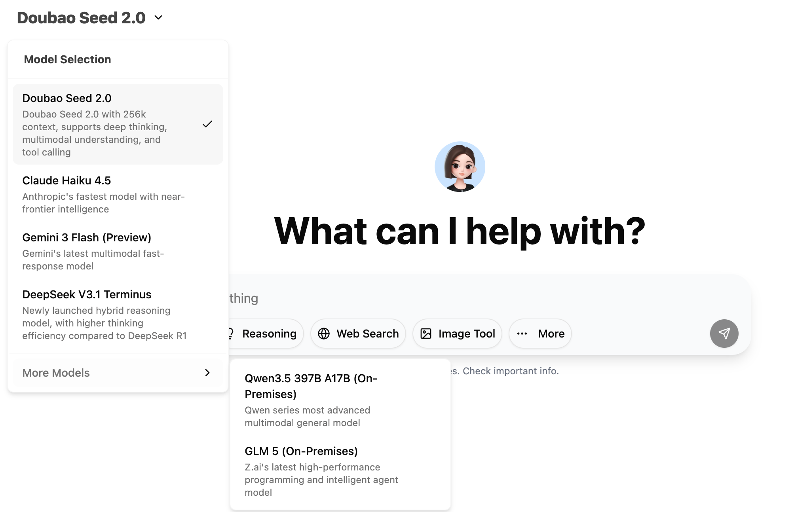
Use AI tools to help you learn coding
ChatGPT/Claude/Gemini/Grok
DeepSeek/Douao/Qwen/Kiwi
Our school has also provided: https://ai.cuhk.edu.cn/chat/

Slide 19
THE END
THANKS

